Slide 1
The Satsifiability Modulo Theories solver Z3 and Applications.
Nikolaj Bjørner
Microsoft Research
Vienna, May 30, 2012

Slide 2
Not so Hidden Agenda
Intro
Lazy
Reduction
Blatant, Shameless Propaganda
SMT?
Eager Reduction
Z3 – An Efficient SMT Solver
Z3?
Theory Solver
Tutorial style
Many techniques apply broadly to SMT solvers: Barcelogic, CVC, Ergo,Mathsat, OpenSMT, Yices, ..
Many tools already use techniques ….
.. But many more tools should really do it too.

Slide 3

Why Engineering Theories?
Support
Rich Theories (and logics) with Efficient Decision Procedures
Auth
MSOL
Sequences
XDucers
Queues
ASP
DL
homomorphisms
Optimization
Orders
Objects
HOL
MultiSets
BAPA
Strings
Reg. Exprs.
NRA
NIA
Floats
f*
*
SAT
EUF
LRA
LIA
Arrays
Bit-Vectors
Alg. DT

Slide 4
We review three methods:
Theory Solver: Optimization, Partial Orders
Reduction: Object Types
Saturation: HOL

Slide 5
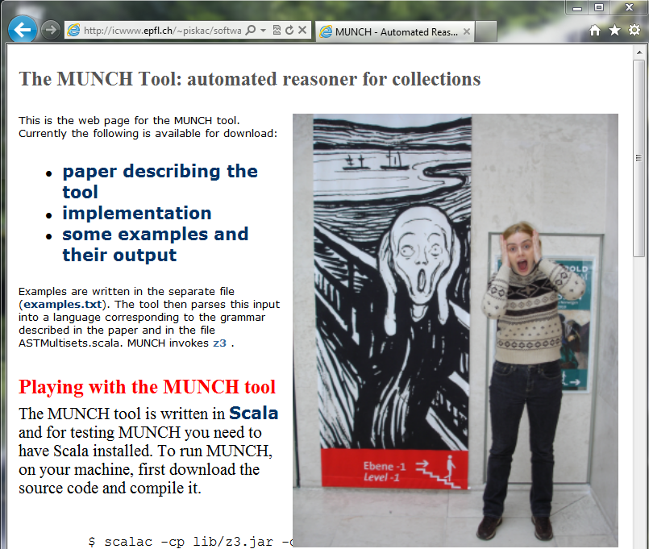
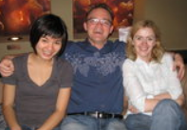
Goal: Tools to make users happy & productive

Slide 6
Overview of methods
Reduction
(eager reduction)
New Theory
Theory Solver
(1st class solver)
Compile
Saturation
(lazy reduction)
Constraints
Model
New
Theory
New
Theory
Equalities
Partial
Compile
Search

Slide 7
SMT
What and Why
Intro
Lazy
Reduction
SMT?
Eager Reduction
Z3?
Theory Solver

Slide 8
Satisfiability Modulo Theories (SMT)
Is formula ϕ satisfiable modulo theory T ?
SMT solvers have specialized algorithms for T

Slide 9
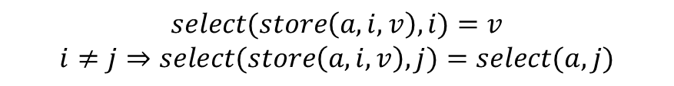
Satisfiability Modulo Theories (SMT)
$$x+2=y⇒f\left(select\left(store\left(a,x,3\right),y−2\right)\right)=f(y−x+1)$$
Array Theory
Arithmetic
Uninterpreted Functions
$$select(store\left(a,i,v\right),i)=v$$
$$i≠j⇒select(store\left(a,i,v\right),j)=select(a,j)$$

Slide 10
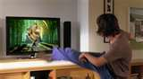
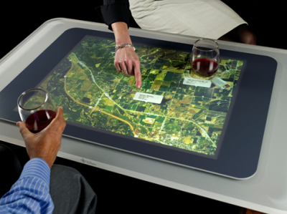
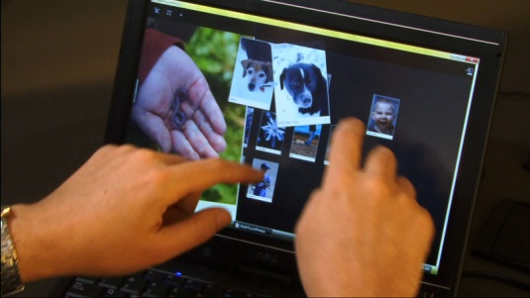



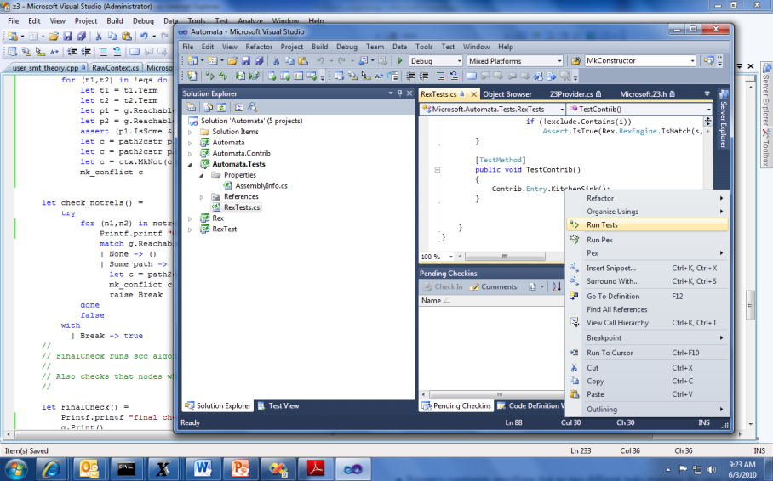


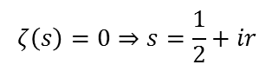
Job Shop Scheduling
Machines
Tasks
Jobs
P = NP?
Laundry
$$ζ\left(s\right)=0⇒s=\frac{1}{2}+ir$$

Slide 11
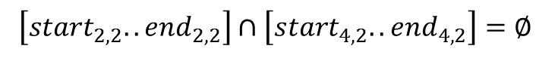
Job Shop Scheduling
Constraints:
Precedence: between two tasks of the same job
Resource: Machines execute at most one job at a time
3
1
2
4
$$\left[start_{2,2}..end_{2,2}\right]∩\left[start_{4,2}..end_{4,2}\right]=∅$$

Slide 12
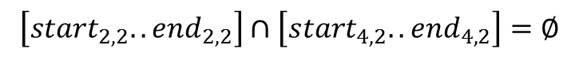
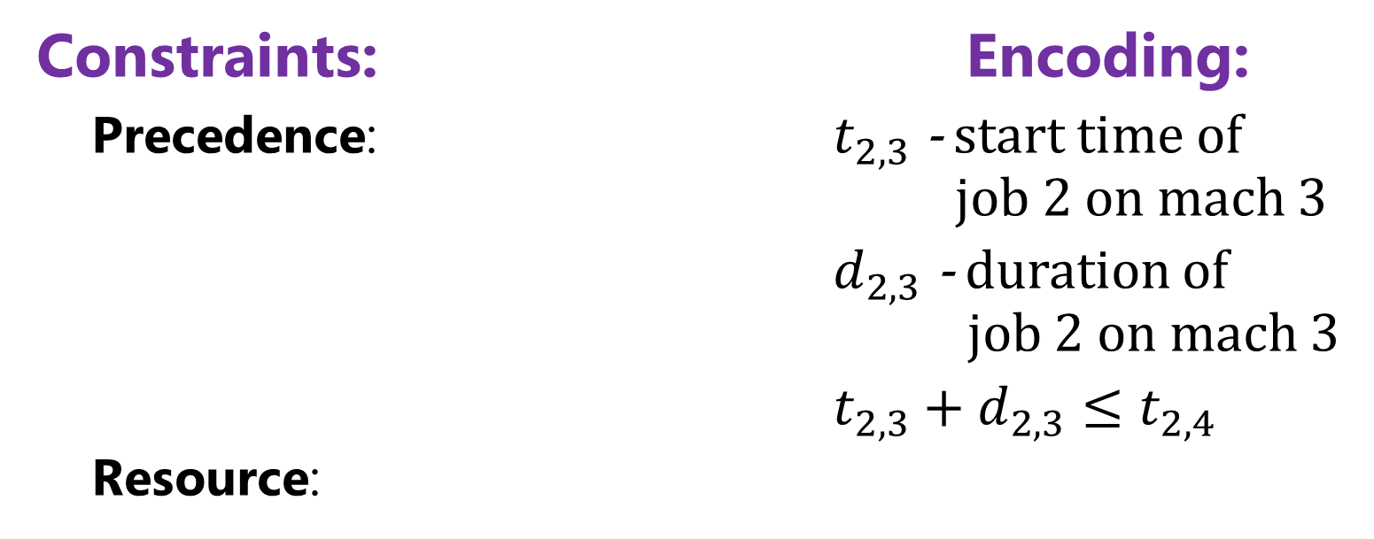
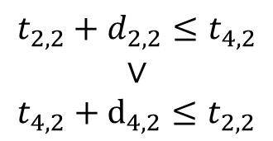
Job Shop Scheduling
Constraints: Encoding:
Precedence: $t_{2,3}$ - start time of job 2 on mach 3
$d_{2,3}$ - duration of job 2 on mach 3
$t_{2,3}+d_{2,3}≤t_{2,4}$
Resource:
3
1
4
2
Not convex
$$t_{2,2}+d_{2,2}≤t_{4,2}$$
$$∨$$
$$t_{4,2}+d_{4,2}≤t_{2,2}$$
$$\left[start_{2,2}..end_{2,2}\right]∩\left[start_{4,2}..end_{4,2}\right]=∅$$

Slide 13
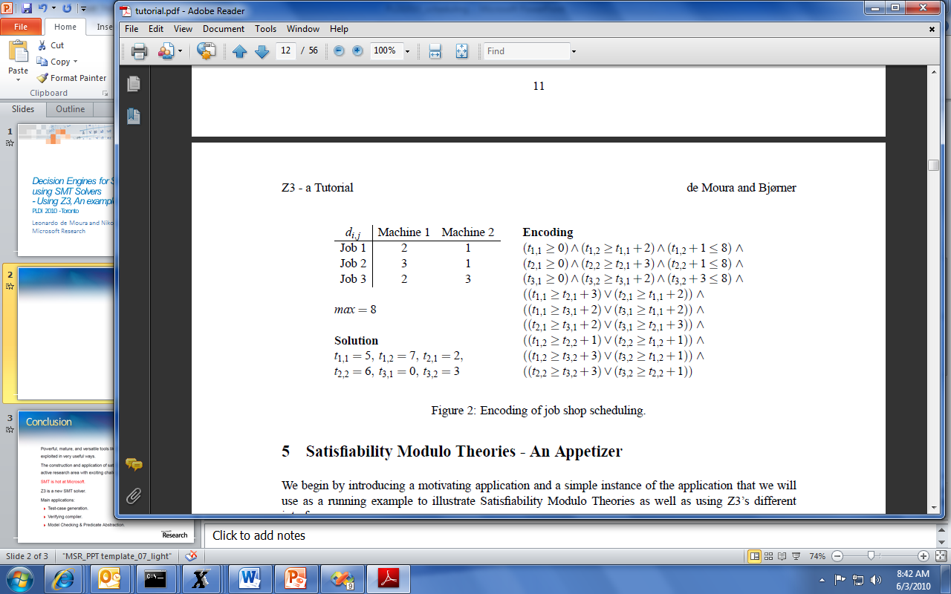
Job Shop Scheduling

Slide 14
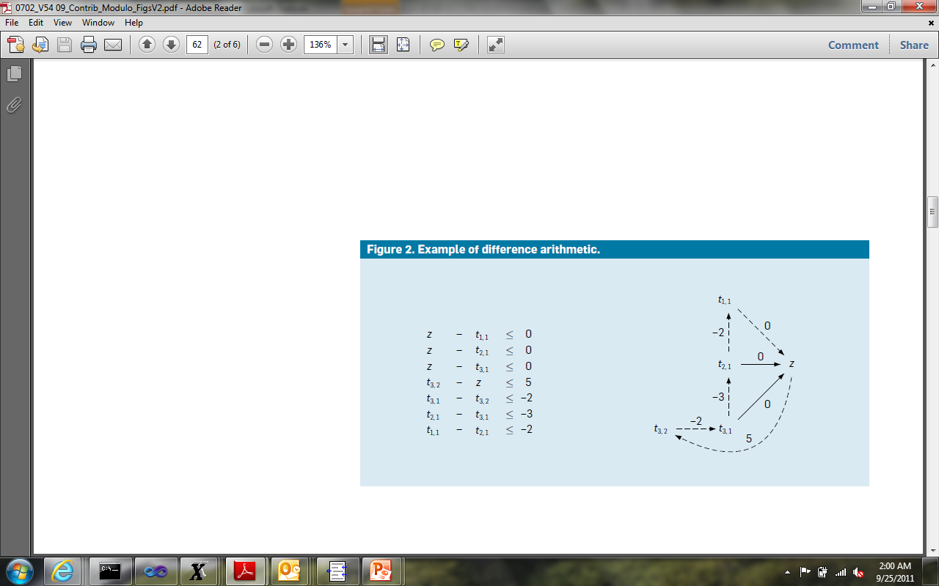
Job Shop Scheduling
Efficient solvers:
- Floyd-Warshal algorithm
- Ford-Fulkerson algorithm
case split
case split
$$z −z= 5 – 2 – 3 – 2 = −2 < 0$$

Slide 15
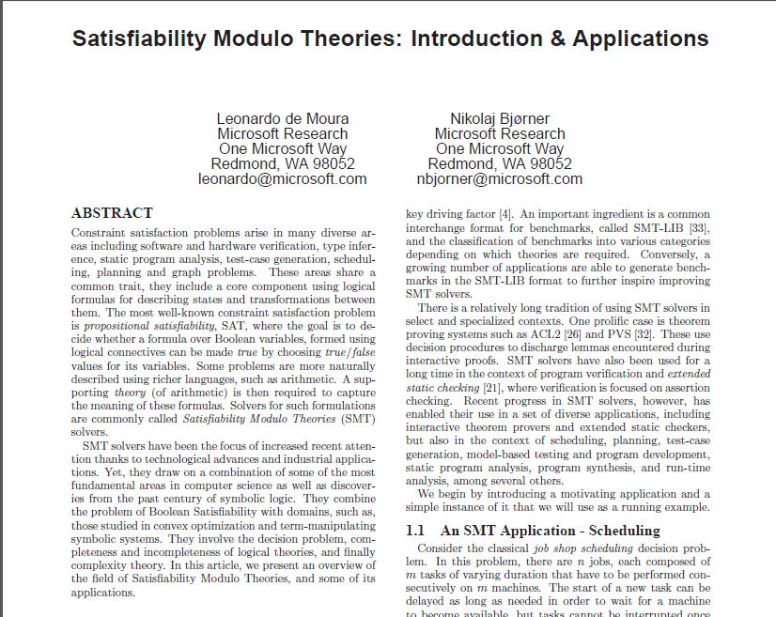

Background Reading
September 2011

Slide 16
Symbolic Engines: SAT, FTP and SMT
SAT: Propositional Satisfiability.
(Tie ∨ Shirt) ∧ ( ¬Tie ∨ ¬Shirt) ∧ (¬Tie ∨ Shirt)
FTP: First-order Theorem Proving.
∀X,Y,Z [X*(Y*Z) = (X*Y)*Z] ∀X [X*inv(X) = e] ∀X [X*e = e]
SMT: Satisfiability Modulo background Theories b + 2 = c ∧ A[3] ≠ A[c-b+1]

Slide 17
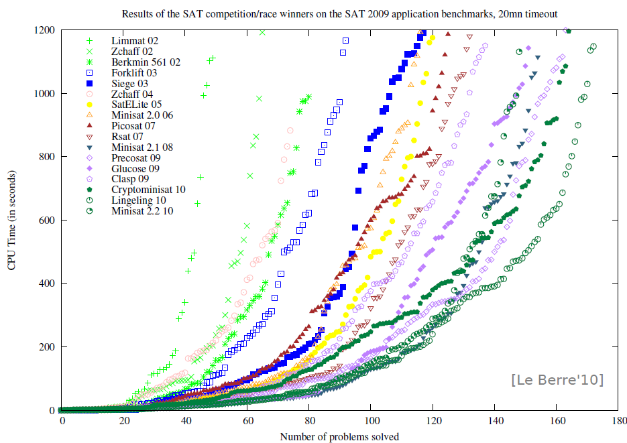
SAT - Milestones
Problems impossible 10 years ago are trivial today
year | Milestone
1960 | Davis-Putnam procedure
1962 | Davis-Logeman-Loveland
1984 | Binary Decision Diagrams
1992 | DIMACS SAT challenge
1994 | SATO: clause indexing
1997 | GRASP: conflict clause learning
1998 | Search Restarts
2001 | zChaff: 2-watch literal, VSIDS
2005 | Preprocessing techniques
2007 | Phase caching
2008 | Cache optimized indexing
2009 | In-processing, clause management
2010 | Blocked clause elimination
Concept
2002
2010
Millions of variables from
HW designs
Courtesy Daniel le Berre

Slide 18
FTP - Milestones
Year | Milestone | Who | Year | Milestone | Who
1930 | Hebrand's theorem | Herbrand | 1970 | Completion and saturation procedures | many people and provers
1934 | Sequent calculi | Gentzen | 1970 | Knuth-Bendix ordering | Knuth; Bendix
1934 | Inverse method | Gentzen | 1971 | Selection function | Kowalski; Kuehner
1955 | Semantic tableaux | Beth | 1972 | Built-in equational theories | Plotkin
1960 | Herbrand-based theorem proving | Wang Hao | 1972 | Prolog | Colmerauer
1960 | Ordered resolution | Davis; Putnam | 1974 | Saturation algorithms | Overbeek
1962 | DLL | Davis; Logemann; Loveland | 1975 | Completeness of paramodulation | Brand
1963 | First-order inverse method | Maslov | 1975 | AC-unification | Stickel
1965 | Unification | J. Robinson | 1976 | Resolution as a decision procedure | Joyner
1965 | First-order resolution | J. Robinson | 1979 | Basic paramodulation | Degtyarev
1965 | Subsumption | J. Robinson | 1980 | Lexicographic path orderings | Kamin; Levy
1967 | Orderings | Slagle | 1985 | Theory resolution | Stickel
1967 | Demodulation or rewriting | Wos; G. Robinson; Carson; Shalla | 1986 | Definitional clause form transformation | Plaisted; Greenbaum
1968 | Model elimination | Loveland | 1988 | Superposition | Zhang
1969 | Paramodulation | G. Robinson; Wos | 1988 | Model construction | Zhang
 |  |  | 1989 | Term indexing | Stickel; Overbeek
 |  |  | 1990 | General theory of redundancy | Bachmair; Ganzinger
 |  |  | 1992 | Basic superposition | Nieuwenhuis; Rubio
 |  |  | 1993 | First instance-based methods | Billon; Plaisted
 |  |  | 1993 | Discount saturation algorithm | Avenhaus; Denzinger
 |  |  | 1998 | Finite model finding using SAT | McCune
 |  |  | 2000 | First-order DPLL | Baumgartner
 |  |  | 2003 | iProver method | Ganzinger; Korovin
 |  |  | 2008 | Sine selection | Hoder
Some success stories:
Open Problems (of 25 years): XCB: X ≡ ((X ≡ Y) ≡ (Z ≡ Y)) ≡ Z) is a single axiom for equivalence
Knowledge Ontologies GBs of formulas
Courtesy Andrei Voronkov, Manchester U

Slide 19
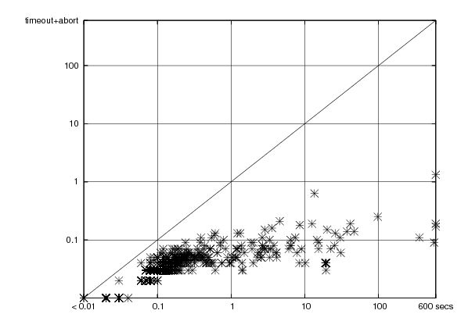
SMT - Milestones
year | Milestone
1977 | Efficient Equality Reasoning
1979 | Theory Combination Foundations
1979 | Arithmetic + Functions
1982 | Combining Canonizing Solvers
1992-8 | Systems: PVS, Simplify, STeP, SVC
2002 | Theory Clause Learning
2005 | SMT competition
2006 | Efficient SAT + Simplex
2007 | Efficient Equality Matching
2009 | Combinatory Array Logic, …
Z3
(of ’07)
Time
On
Boogie Regression
1sec
Simplify (of ’01) time
Z3
Time
On
VCC
Regression
Includes progress from SAT:
SAT
Theory
Solvers
SMT
15KLOC + 285KLOC = Z3
Nov 08
March 09

Slide 20
Z3
An Efficient SMT Solver
From Microsoft Research
Intro
Lazy
Reduction
SMT?
Eager Reduction
Z3?
Theory Solver
By Leonardo de Moura, Nikolaj Bjørner,
Christoph Wintersteiger

Slide 21
Z3: Little Engines of Proof
Quant. Instances
Simplex
Bit-Arith
Congruence Closure
SAT Solver
Simplifier
Super-position
Arrays
Datatypes
User-Theories
Q- Elim
MBQI
Freely available from http://research.microsoft.com/projects/z3

Slide 22
Research around Z3
Decision Procedures
Modular Difference Logic is Hard TR 08 B, Blass Gurevich, Muthuvathi.
Linear Functional Fixed-points. CAV 09 B. & Hendrix.
A Priori Reductions to Zero for Strategy-Independent Gröbner Bases SYNASC 09 M& Passmore.
Efficient, Generalized Array Decision Procedures FMCAD 09 M & B
Quantifier Elimination as an Abstract Decision Procedure IJCAR 10, B
Cutting to the Chase CADE 11, Jojanovich, M
Combining Decision Procedures
Model-based Theory Combination SMT 07 M & B. .
Accelerating Lemma learning using DPLL(U) LPAR 08 B, Dutetre & M
Proofs, Refutations and Z3 IWIL 08 M & B
On Locally Minimal Nullstellensatz Proofs. SMT 09 M & Passmore.
A Concurrent Portfolio Approach to SMT Solving CAV 09 Wintersteiger, Hamadi & M
Conflict Directed Theory Resolution Cambridge Univ. Press 12, M & B
Quantifiers, quantifiers, quantifiers
Efficient E-matching for SMT Solvers. CADE 07 M & B.
Relevancy Propagation. TR 07 M & B.
Deciding Effectively Propositional Logic using DPLL and substitution sets IJCAR 08 M & B.
Engineering DPLL(T) + saturation. IJCAR 08 M & B.
Complete instantiation for quantified SMT formulas CAV 09 Ge & M.
On deciding satisfiability by DPLL( Γ+ T) and unsound theorem proving.
CADE 09 Bonachina, M & Lynch. .
.
.
.

Slide 23
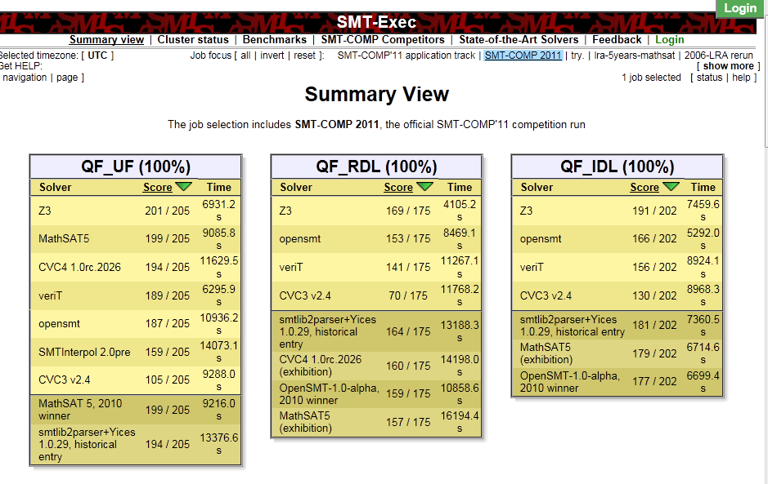
Fast and powerful
Z3 is Free Software
for research
http://smtcomp.org

Slide 24
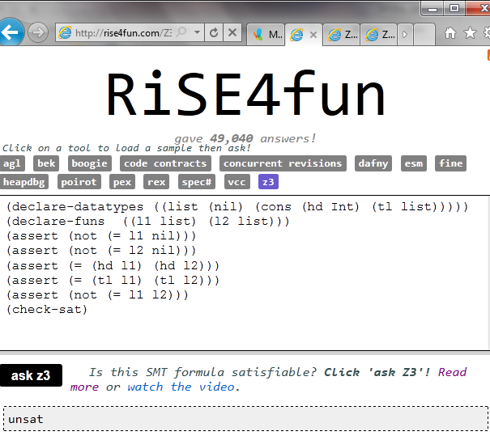
Theories
Uninterpreted functions
Arithmetic (linear)
Bit-vectors
Algebraic data-types
Arrays
User-defined

Slide 25

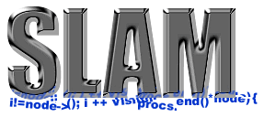

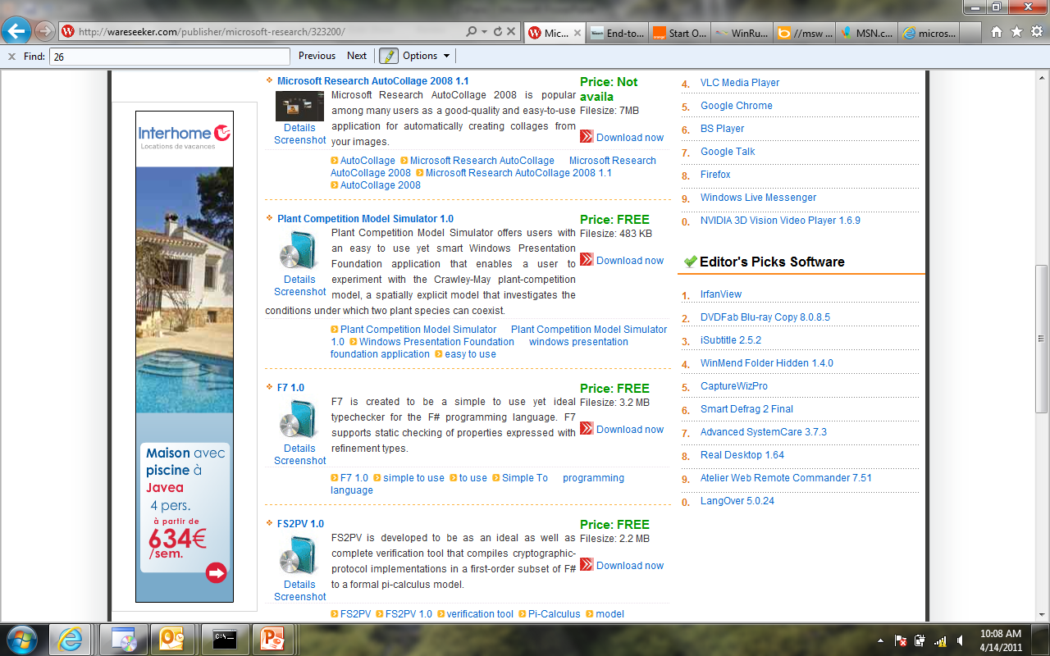
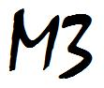

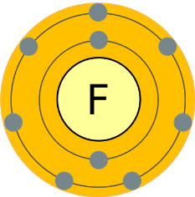

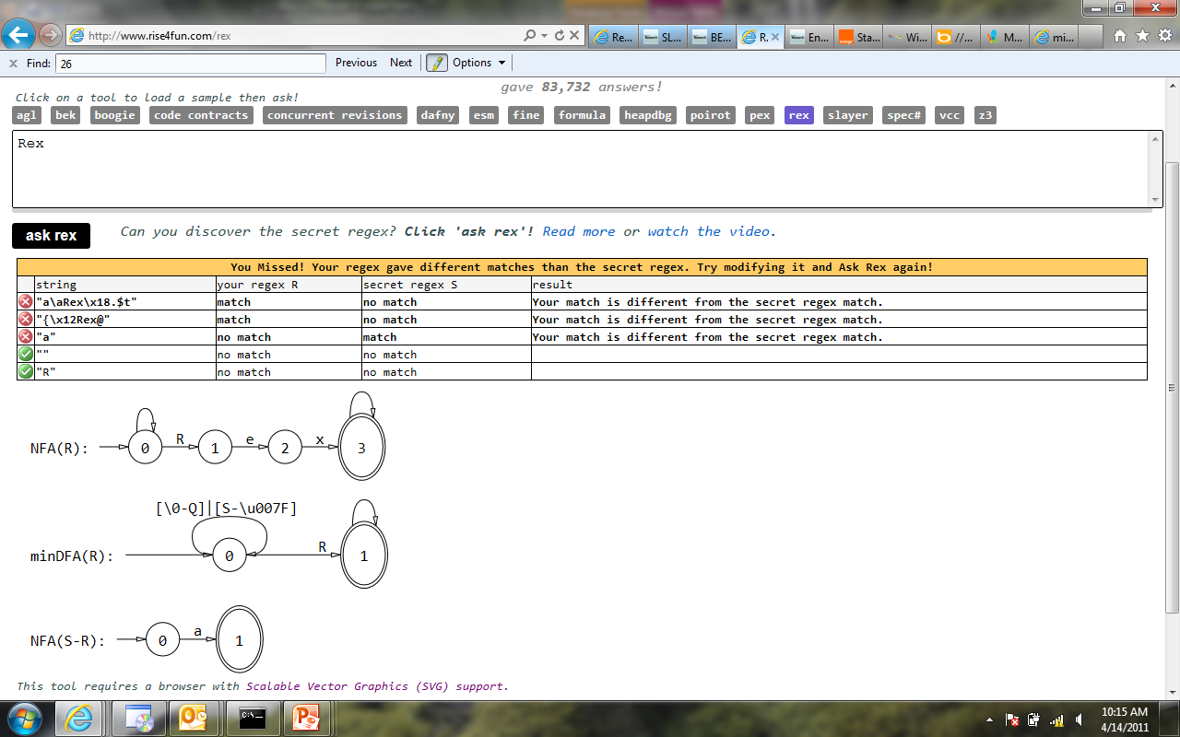
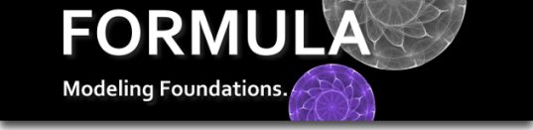



Some Microsoft tools using Z3
Property Execution Model
Driven Guided Based
Program
Verification
Auditing
Type Safety
Over-Approximation
Under-Approximation
Testing
Analysis
Synthesis
BEK
HAVOC
SLAyer
SAGE

Slide 26
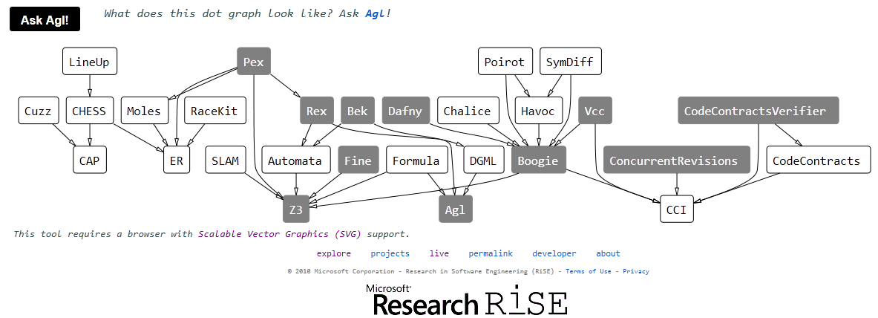
Some Microsoft tools using Z3
http://rise4fun.com

Slide 27
SAGE by numbers
100+ CPU-years - largest dedicated fuzz lab in the world
100s apps - fuzzed using SAGE
100s previously unknown bugs found
1,000,000,000+ computers updated with bug fixes
Millions of $ saved for Users and Microsoft
10s of related tools (incl. Pex), 100s DART citations
1,000,000,000+ constraints - largest usage for any SMT solver
Adapted from [Patrice Godefroid, ISSTA 2010]

Slide 28

Building Verve
9 person-months
Source file
Kernel.cs
Verification tool
Compilation tool
C# compiler
Verified
Nucleus.bpl (x86)
Kernel.obj (x86)
Boogie/Z3
TAL checker
Translator/
Assembler
Linker/ISO generator
Verve.iso
Notes:
In additions to the Nucleus we have the kernel and applications in C#, which we compiled to typed assembly using Bartok. We check this using the Tal checker.
The C# code is untrusted: we do not have to trust its correctness because any C# code that runs goes through the TAL checker.
To create the bootable CD-ROM image, we translate and assembly the Nucleus and link it with the kernel.
Other than the trusted specification, all other instructions in the system have been verified.
TRANSITION: Now we will show that we have indeed built a real system using a scalable approach.

Slide 29
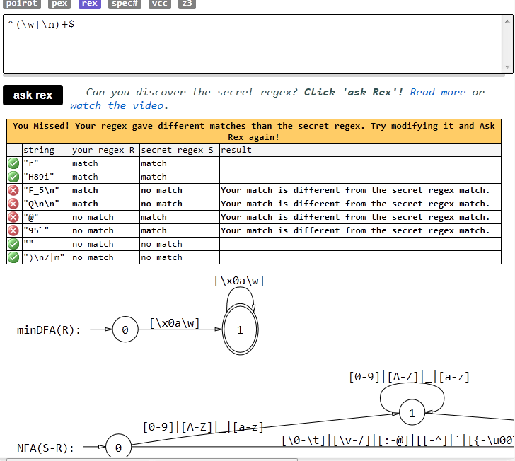
Rex – Regular Expression Exploration

Slide 30
Optimization
Reduction
New Theory
Theory
Solver
Compile
Constraints
Model
Saturation
New
Theory
New
Theory
Eqs
Partial
Compile
Search
Get More Satisfaction with SMT
Intro
Lazy
Reduction
SMT?
Eager Reduction
Z3?
Theory Solver
Oliveras, Nieuenhuis, SAT 2006

Slide 31
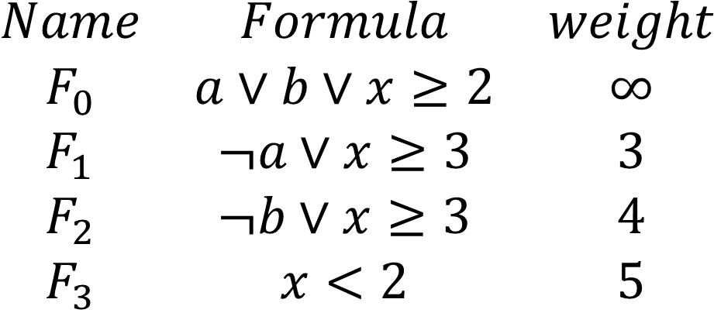
Weighted MaxSMT
$$\begin{matrix}Name & Formula & weight \\ F_{0} & a∨b∨x≥2 & ∞ \\ F_{1} & ¬a∨x≥3 & 3 \\ F_{2} & ¬b∨x≥3 & 4 \\ F_{3} & x<2 & 5\end{matrix}$$
Unsat

Slide 32
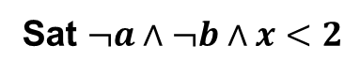
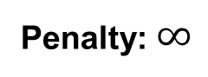
Weighted MaxSMT
$$\begin{matrix}Name & Formula & weight \\ F_{0} & a∨b∨x≥2 & ∞ \\ F_{1} & ¬a∨x≥3 & 3 \\ F_{2} & ¬b∨x≥3 & 4 \\ F_{3} & x<2 & 5\end{matrix}$$
Penalty: $∞$
Sat $¬a∧¬b∧x<2$

Slide 33
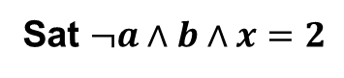
Weighted MaxSMT
$$\begin{matrix}Name & Formula & weight \\ F_{0} & a∨b∨x≥2 & ∞ \\ F_{1} & ¬a∨x≥3 & 3 \\ F_{2} & ¬b∨x≥3 & 4 \\ F_{3} & x<2 & 5\end{matrix}$$
Sat $¬a∧b∧x=2$
Penalty: 9 = 4 + 5

Slide 34
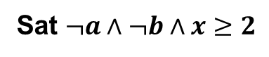
Weighted MaxSMT
$$\begin{matrix}Name & Formula & weight \\ F_{0} & a∨b∨x≥2 & ∞ \\ F_{1} & ¬a∨x≥3 & 3 \\ F_{2} & ¬b∨x≥3 & 4 \\ F_{3} & x<2 & 5\end{matrix}$$
Sat $¬a∧¬b∧x≥2$
Penalty: 5

Slide 35
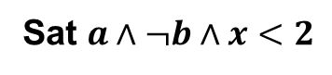
Weighted MaxSMT
$$\begin{matrix}Name & Formula & weight \\ F_{0} & a∨b∨x≥2 & ∞ \\ F_{1} & ¬a∨x≥3 & 3 \\ F_{2} & ¬b∨x≥3 & 4 \\ F_{3} & x<2 & 5\end{matrix}$$
Penalty: 3
Sat $a∧¬b∧x<2$

Slide 36
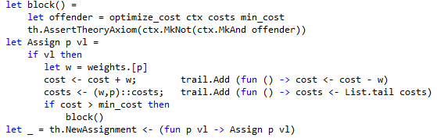
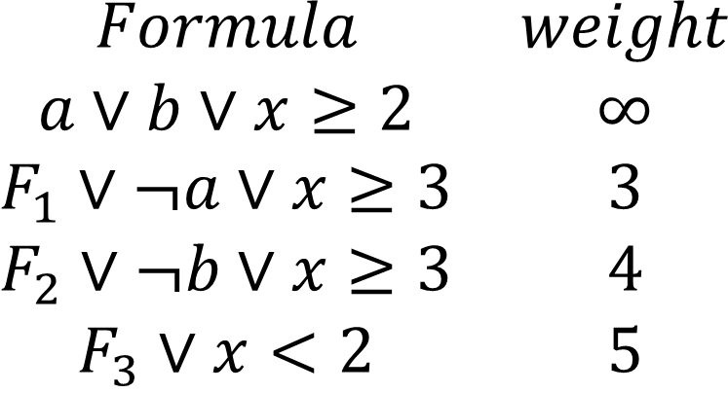
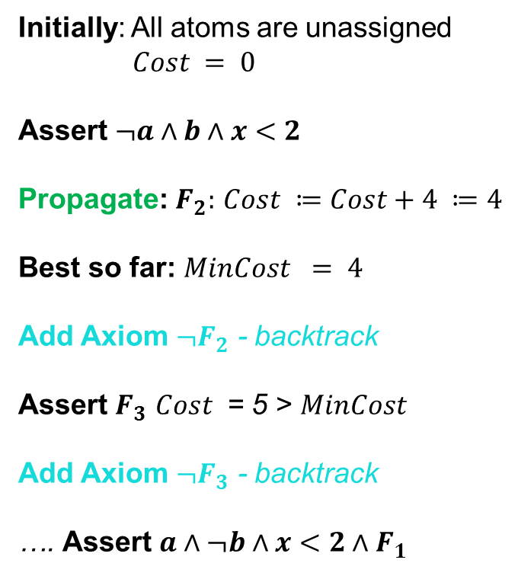
Weighted MaxSMT
$$\begin{matrix}Formula & weight \\ a∨b∨x≥2 & ∞ \\ F_{1}∨¬a∨x≥3 & 3 \\ F_{2}∨¬b∨x≥3 & 4 \\ F_{3}∨x<2 & 5\end{matrix}$$
Initially: All atoms are unassigned
$Cost = 0$
Assert $¬a∧b∧x<2$
Propagate: $F_{2}:$ $Cost ≔Cost+4 ≔4$
Best so far: $MinCost = 4$
Add Axiom ${¬F}_{2}$ - backtrack
Assert $F_{3}$ $Cost$ = 5 > $MinCost$
Add Axiom ${¬F}_{3}$ - backtrack
…. Assert $a∧¬b∧x<2∧F_{1}$
What does it take to encode this in Z3?

Slide 37
Principles of Modern SMT solvers in two slides

Slide 38
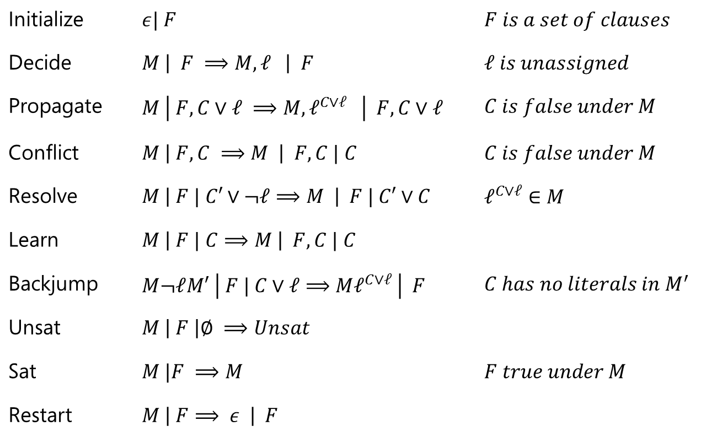
Modern DPLL in a nutshell
Initialize | $ε| F$ | $F is a set of clauses$
Decide | $M \left| F ⟹M, ℓ \right| F$ | $ℓ is unassigned$
Propagate | $M \left| F, C∨ℓ ⟹M, ℓ^{C∨ℓ} \right| F,C∨ℓ$ | $C is false under M$
Conflict | $M \left| F, C ⟹M \right| F,C | C$ | $C is false under M$
Resolve | $M \left| F | C′∨¬ℓ⟹M \right| F | C′∨C$ | $ℓ^{C∨ℓ}∈M$
Learn | $M \left| F | C⟹M \right| F, C | C$
Backjump | $M¬ℓM′ \left| F | C∨ℓ⟹Mℓ^{C∨ℓ} \right| F$ | ${C has no literals in M}^{′}$
Unsat | $M \left| F \right|∅ ⟹Unsat$
Sat | $M |F ⟹M$ | $F true under M$
Restart | $M \left| F⟹ ε \right| F$
Adapted and modified from [Nieuwenhuis, Oliveras, Tinelli J.ACM 06]

Slide 39
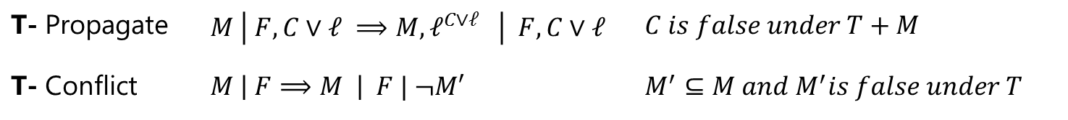
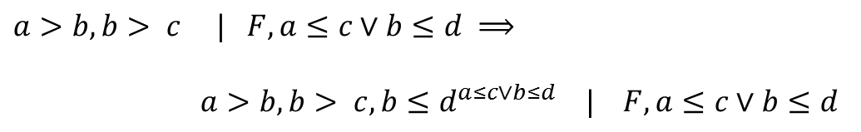
DPLL(T) solver interaction
T- Propagate | $M \left| F, C∨ℓ ⟹M, ℓ^{C∨ℓ} \right| F,C∨ℓ$ | $C is false under T+M$
T- Conflict | $M \left| F⟹M \right| F | ¬M′$ | $M^{′}⊆M and M^{′}is false under T$
T- Propagate
$a>b, b> c | F, a≤c∨b≤d ⟹$
$a>b, b> c, b≤d^{a≤c∨b≤d} | F, a≤c∨b≤d$
T- Conflict
$M | F⟹$ $M | F, a≤b∨b≤c∨c<a$
$$where a>b, b> c, a≤c⊆M$$

Slide 40
How does Z3 enable T solvers?

Slide 41
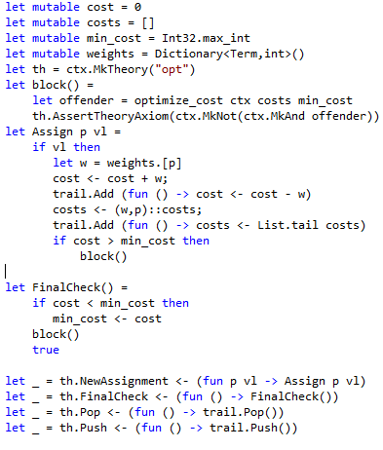
DPLL(T) Solver Interaction
Calls into DPLL engine
T-Propagate
T-Conflict
Callbacks from DPLL engine
Callbacks from DPLL engine with new assignment
T-Propagate
T-Conflict
Calls into DPLL engine

Slide 42
Partial Orders & Object Hierarcies
Reduction
New Theory
Theory
Solver
Compile
Constraints
Model
Saturation
New
Theory
New
Theory
Eqs
Partial
Compile
Search
Intro
Lazy
Reduction
SMT?
Eager Reduction
Acyclic graphs and SMT
Z3?
Theory Solver

Slide 43



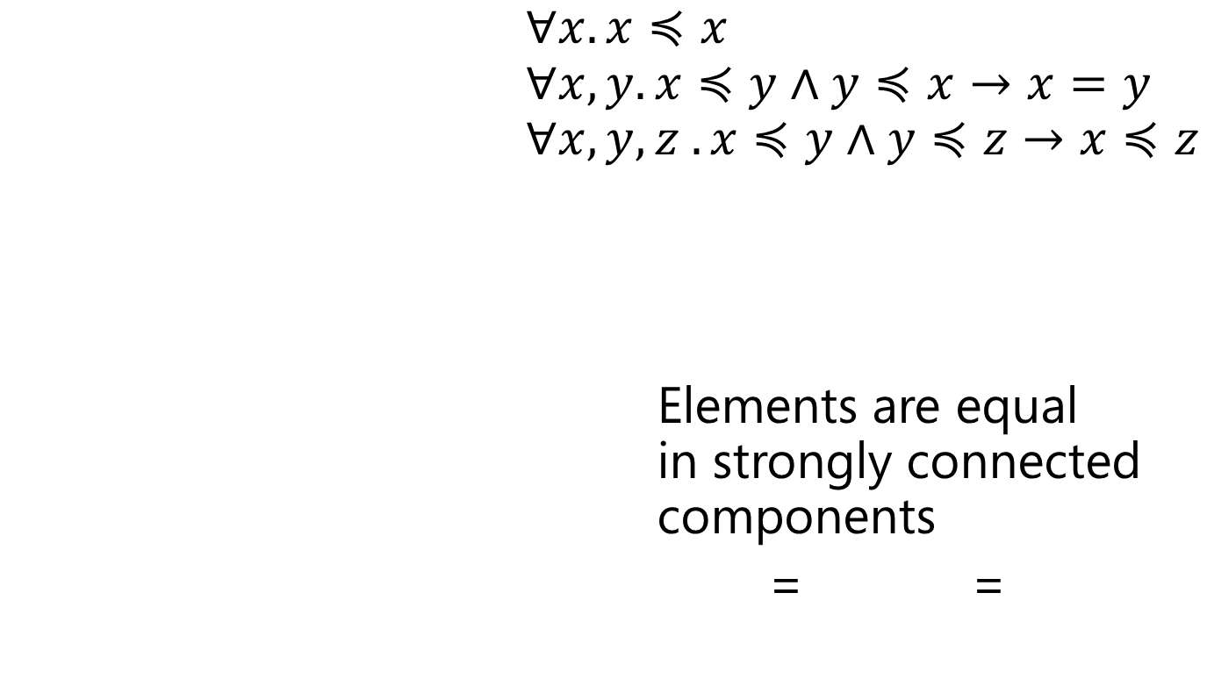



Partial Orders as Acyclic Graphs
$∀x. x≼x$ $∀x,y. x≼y∧y≼x→x=y$ $∀x, y, z . x≼y∧y≼z→x≼z$
Elements are equal in strongly connected components
= =
$$≼$$
$$≼$$
$$≼$$
$$≽$$
$$≼$$
$$≼$$

Slide 44

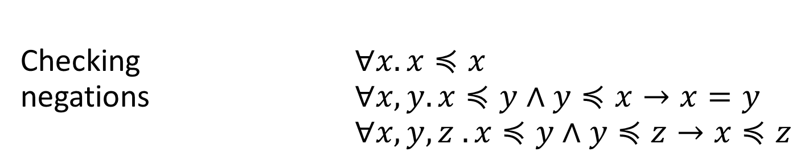



Partial Orders as Acyclic Graphs
Checking $∀x. x≼x$ negations $∀x,y. x≼y∧y≼x→x=y$ $∀x, y, z . x≼y∧y≼z→x≼z$
$$≼$$
$$≼$$
$$≼$$
$$≼$$
$$≼$$
$$≼$$
$$¬≼$$
$$¬≼$$
$$≼$$
$$≼$$
$$≼$$
$$≼$$
OK
Not OK

Slide 45
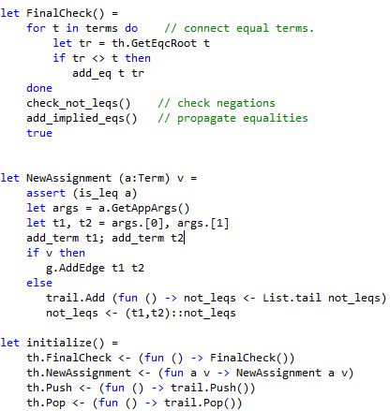





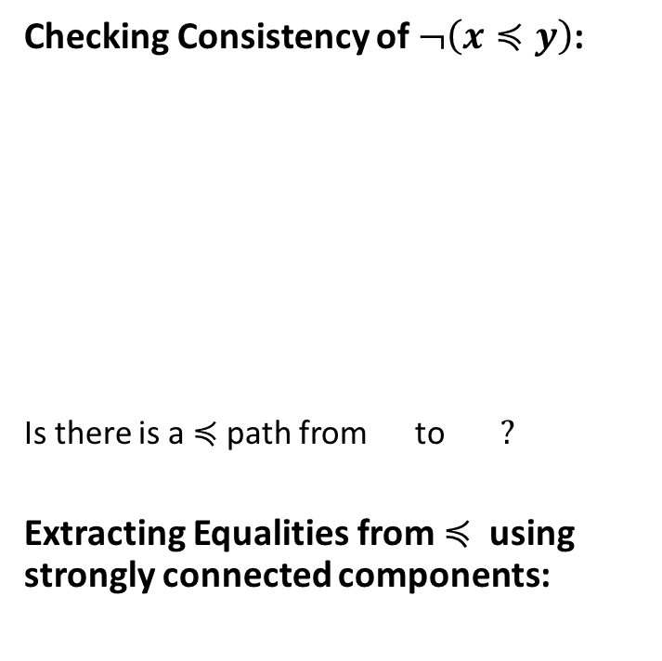







Partial Orders as Acyclic Graphs
Checking Consistency of $¬\left(x≼y\right)$:
Is there is a $≼$path from to $?$
Extracting Equalities from $≼$using strongly connected components:
$$≼$$
$$≼$$
$$≼$$
$$¬≼$$
$$≼$$
$$≼$$
$$≼$$
$$≼$$
$$≼$$
$$≽$$
$$≼$$
$$≼$$

Slide 46
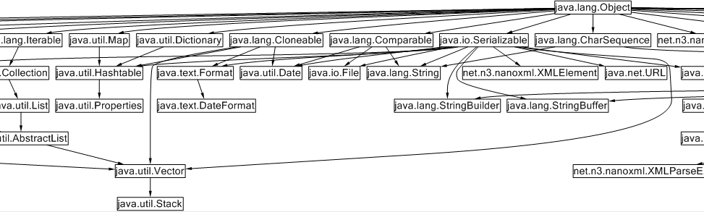
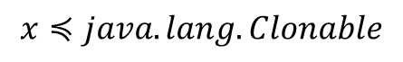
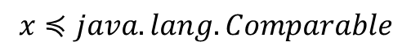
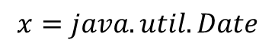
Inheritance as table-lookup
$$x≼java.lang.Comparable$$
Efficient propagators using
Type Slicing algorithm
Leverages ordering of children
J. Gil and Y. Zibin.[TOPLAS 2007]
Available as F#/Z3 sample
$$x≼java.lang.Clonable$$
$$x=java.util.Date$$
Sherman, Garvin, Dwyer. IJCAR 2010

Slide 47
Object Graphs
Reduction
New Theory
Theory
Solver
Compile
Constraints
Model
Saturation
New
Theory
New
Theory
Eqs
Partial
Compile
Search
Intro
Lazy
Reduction
To Cycle and not to Cycle
SMT?
Eager Reduction
Z3?
Theory Solver
from Pex

Slide 48
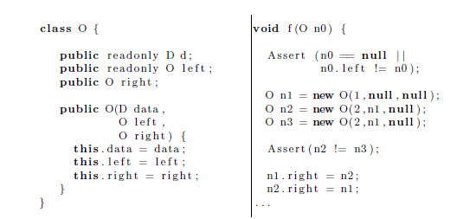
A Theory of Objects
Objects are
non-extensional
Read-only fields
Heap can be updated

Slide 49
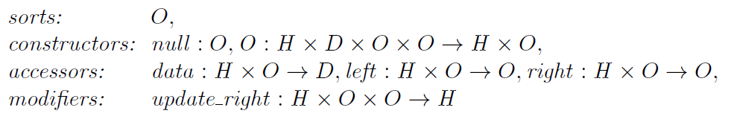


A Theory of Objects
So far so good, but what about read-only fields?

Slide 50



Encoding: Heaps as Arrays
Domains: objects are Natural numbers, left child is a smaller number
Most axioms follow by function definitions.
…
Only Axiom: Instantiate for every occurrence of left(h,o)

Slide 51


Encoding: Heaps as Arrays+Data-Types
Domains: read-only fields use algebraic data-types
Most axioms follow by function definitions.
No Extra Axiom: Data-type theory enforces acyclicity over left
$⇒$ More efficient search

Slide 52

HOL
Reduction
New Theory
Theory
Solver
Compile
Constraints
Model
Saturation
New
Theory
New
Theory
Eqs
Partial
Compile
Search
Z3 at the service of
Γ,Π,Σ,α,β,λ,η,κ,*,$□$
Intro
Lazy
Reduction
SMT?
Eager Reduction
Z3?
Theory Solver
SMT version of Satalax, Brown, CADE 2011

Slide 53







Types and Z3 do mingle
Sledge Hammer
Armand, Grégoire, Keller, Théry, Werner

Slide 54
But
Used for First-Order Theorems

Slide 55




Sure, often
HOL (problem)
is just
FO (solution)
in disguise
“We are all faced with a series of great opportunities brilliantly disguised as unsolvable problems.”
“For every problem there is a solution which is simple, clean and wrong.”
John W. Gardner
Henry Louis Mencken

Slide 56

Digression: CAL
CAL – Combinatory Array Logic
$$store\left(a,i,v\right)=λj. if i=j then v else a\left[j\right]$$
$$K\left(v\right)=λj . v$$
$$map_{f}\left(a,b\right)=λj . f(a\left[j\right],b\left[j\right])$$
Existential fragment is in NP by reduction to congruence closure using polynomial set of instances.

Slide 57

but can we do something more HOLish?
e.g.,
$$∀f. \left(∀x,y. f\left(x\right)=f\left(y\right)→x=y\right)→∃g . ∀x . x=g(f\left(x\right))$$

Slide 58




Idea: Saturate for Henkin Models
$$σ∷=i \left| o τ∷=σ \right| τ→τ$$
Types
Terms
Constants
Axioms
$$M, N ∷=λx:τ. M \left| \left(M N\right) \right| x$$
$$false :o ⇒ :o→o→o$$
$$ε: \left(τ→o\right)→τ, ∀: \left(τ→o\right)→o,$$
$$=:τ→τ→o$$

Slide 59



Lazy Saturation loop
HOL formula $F$
Assert $⟦F⟧$
$$F←F∧F_{Inst}$$
Check SAT
Instantiate
Unsat
Model

Slide 60






HOL $⇒$SMT
HOL formula $F$
Assert $⟦F⟧$
$$F←F∧F_{Inst}$$
Check SAT
Instantiate
Unsat
Model
$$⟦_⟧:HOL →SMT$$
Propositional
reasoning
SAT
Equalities
Congruence
Closure
SMT
Extensional
arrays

Slide 61






$βη$ long NF
HOL formula $F$
Assert $⟦F⟧$
$$F←F∧F_{Inst}$$
Check SAT
Instantiate
Unsat
Model
Set of $βη$ long NF terms with free variables from $Γ$ of type $τ$
Enumerate $T[Γ;τ]$ by depth:
Many more algorithms (matching, unification)/optimizations required for anything viable…
… but main task of Boolean search, equalities, functions is delegated

Slide 62
Conclusions
We surveyed three methods for adding new theories (logics) to Z3:
As 1st class Theory Solver
Eager reduction: embed theory in Z3
Lazy reduction: add facts on demand
Choose one that fits your theory!

Slide 63
[Zvonimir Rakamaric, Roberto Bruttomesso, Alan J. Hu, Alessandro Cimatti: Verifying Heap-Manipulating Programs in an SMT Framework. ATVA 2007: 237-252]
[Stan Rosenberg, Anindya Banerjee and David Naumann. Decision Procedures for Region Logic. VMCAI 2012]

Slide 64
Theories vs. Problem Classes
Applications often generate problems with particular characteristics (many ground clauses/bit-vectors + predicates/arithmetic + transendentals/..)
New Z3 feature by de Moura & Passmore:
Compose strategies using tactical interface.

